Slide 1
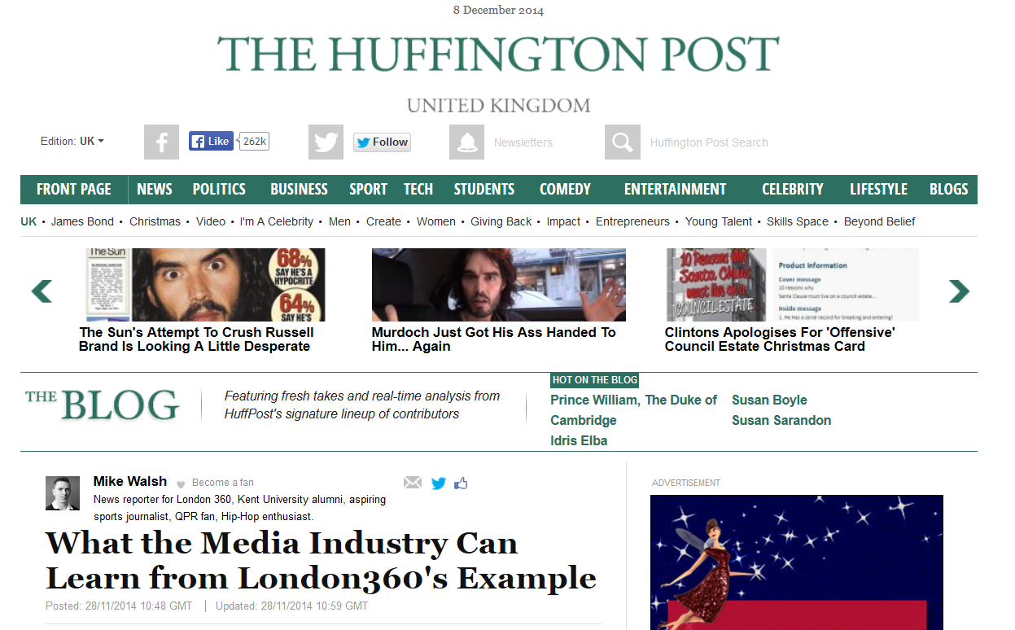
Vivien Morgan mention as a ‘renowned’ tutor
Mike Walsh’s thoughts on the Media Trust training
My London360 experience started with a week of shadowing the pervious team who were wrapping up their series when we were presented with the opportunity of interviewing TV and Film genius Noel Clarke. This was a sign of things to come as we would be presented with exciting opportunities like this throughout our tenure. It was incredible to have the chance to pick the brain of one of the biggest names in British film on a one-to-one basis, a very motivational day.
The first month of our time at London360 was filled with master-classes with experts in respective fields which provided all round media training. We were treated to classes with leading social media leader Andrew Davis, a journalistic session with the renowned Vivien Morgan and producer Angela Ferreira amongst others. The team were also given intensive training in camera work and editing which fully equipped us to begin our careers as London360 producers and reporters.

